Slide 1
CAPSTONE PROJECT
HEART DISEASE ANALYSIS
PRESENTED BY
ARCHANA. J
112721203002
B.TECH.CHEMICAL ENGINEERING
ST.PETER’S COLLEGE OF ENGINEERING AND TECHNOLOGY

Slide 2
PROBLEM STATEMENT
Develop a predictive model for the early detection of heart disease using machine learning techniques. The model will analyze a dataset containing patient information such as age, sex, cholesterol levels, blood pressure, and other relevant factors to predict the likelihood of a patient developing heart disease. The goal is to create a reliable tool that can assist healthcare providers in identifying high-risk patients and implementing preventive measures to reduce the incidence of heart disease and improve patient outcomes.

Slide 3
PROPOSED SOLUTION
Data Collection: Gather a dataset with patient demographics, medical history, and diagnostic test results.
Data Preprocessing: Clean data, handle missing values, and normalize numerical features.
Exploratory Data Analysis (EDA): Analyze data distributions, correlations, and outliers.
Feature Selection: Select relevant features using correlation analysis or feature importance.
Model Selection: Choose classification models like logistic regression, decision trees, or random forests.
Model Training: Split data into training and testing sets, use cross-validation, and fine-tune hyperparameters.
Model Evaluation: Evaluate model performance using metrics like accuracy, precision, recall, and ROC-AUC.
Deployment: Deploy the model into a production environment for real-time predictions.
Monitoring and Maintenance: Monitor model performance and retrain with new data periodically.
Ethical Considerations: Adhere to ethical guidelines regarding patient data privacy and informed consent.

Slide 4
SYSTEM APPROACH(HARD WARE & SOFTWARE)
Building the proposed solution would evolve a combination of data processing, future engineering, and machine learning.
Here are the key system and library Requirements:
1. Hardware: A computer with a sufficient processing power, preferably with multiple cores or a GPU for faster training of machine learning models .Adequate RAM to handle the size of the data set and computational requirements
2. Software:- An operating system compatible with the required machine learning libraries (e.g., Windows, Linux, macOS.)

Slide 5
SYSTEM APPROACH CONT
Library requirements
numpy
pandas
scipy
seaborn
Python
For data visualization
matplotlib

Slide 6
ALGORITHM AND DEPLOYMENT
Data exploration:
Explore the heart disease data set structure features and target variable
Identifying potential patterns, correlations and outliers
Problem formulation
Define the problem: predict heart disease spread across the age groups
Algorithm selection
Data Preprocessing:
Imputation: Use algorithms like mean, median, or mode imputation to handle missing data in your heart disease dataset.
Normalization/Standardization: Depending on the algorithm you plan to use for analysis, you might need to normalize or standardize your data to ensure that all features contribute equally.
Analysis:
Statistical Analysis: You might use statistical tests like t-tests or ANOVA to compare heart disease metrics between different groups or countries.
Correlation Analysis: Use correlation analysis to understand the relationships between different heart disease metrics such as cases, deaths, and testing rates.

Slide 7
DATA INPUT
Data collection:
Gather age, sex, chest pain type resting blood pressure int64 cholesterol fasting blood sugar resting electrocardiogram maximum heart rate achieved in exercise induced angina depression major vessels thalassemia.
Data cleaning: using encoding techniques, convert categories into numerical data, and handle any inconsistencies

Slide 8
PREDICTION PROCESS
New data input : collect new data or use existing data to make predictions
Pre processing : apply the same data preprocessing steps(cleaning, feature engineering, scaling)to the new data
Model inference: use the trained model to make predictions on the new data
Results interpretation: interpret the model’s prediction, the context of the problem at hand. For regression , interpret the predicted values as optimal rates or lengths of effect.

Slide 9
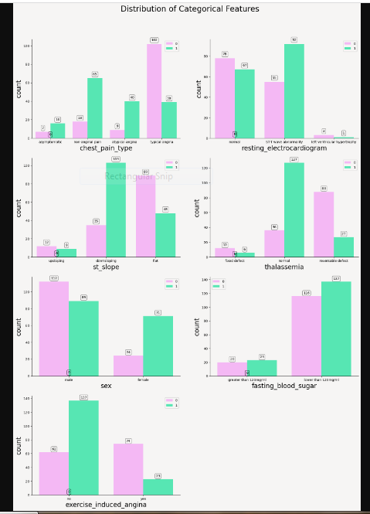
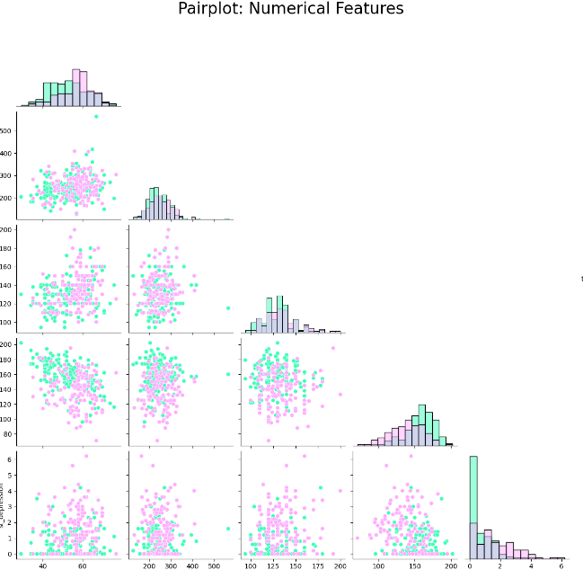
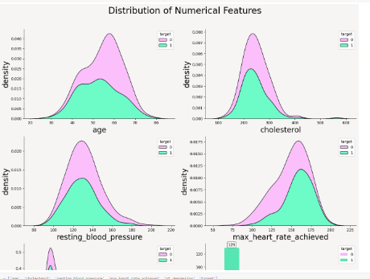
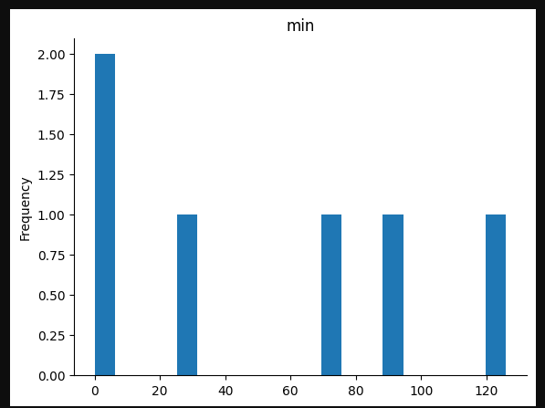
RESULT

Slide 10
CONCLUSION
This analysis summarizes the modeling, simulation, and analytics work around the heart diseases across the age groups from the perspective of data science and visual analytics. It examines the impact of best practices and preventive measures in various sectors and enables conditions to be managed with available health resources.

Slide 11
FUTURE SCOPE
Enhanced Data Analysis: As more data becomes available, you can enhance your analysis by incorporating additional datasets.
Machine Learning for Prediction: You can expand the project to include more sophisticated machine learning models for predicting heart disease trends. This could involve using advanced algorithms or incorporating additional features into your models.
Integration with Public Health Responses: Collaborate with public health authorities to integrate your analysis into their decision-making processes, providing them with insights to inform their response strategies.
Education and Outreach: Use your visualizations and analysis to educate the public about risk of heart disease and the importance of preventive measures, such as diet and active lifestyle.

Slide 12
REFERENCES
https://www.kaggle.com/tentotheminus9/what-causes-heart-disease-explaining
https://towardsdatascience.com/the-search-for-categorical-correlation-a1cf7f1888c9
https://scikit-learn.org/stable/auto_examples/classification/plot_classifier_comparison.html
https://www.kaggle.com/learn/machine-learning-explainability
https://shap.readthedocs.io/en/latest/index.html
https://www.healthline.com/health/serum-cholesterol#treatment
https://www.who.int/news-room/fact-sheets/detail/cardiovascular-diseases-(cvds)

